Slide 1
Car Price prediction
Problem Statement:
A With the covid 19 impact in the market, we have seen lot of changes in the car market. Now some cars are in demand hence making them costly and some are not in demand hence cheaper. One of our clients works with small traders, who sell used cars. With the change in market due to covid 19 impact, our client is facing problems with their previous car price valuation machine learning models. So, they are looking for new machine learning models from new data. We have to make car price valuation model.
This project contains of two phases:
Data collection using selenium and beautiful soup
Model building phase.,
Data cleaning
Exploratory data analysis
Data Pre-processing
Model building and
model evaluation

Slide 2
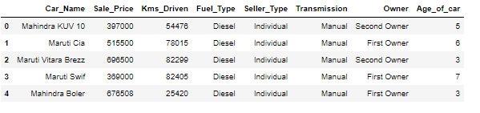
EDA
Data contains the below features
And the shape of the data is 4946 , 6

Slide 3
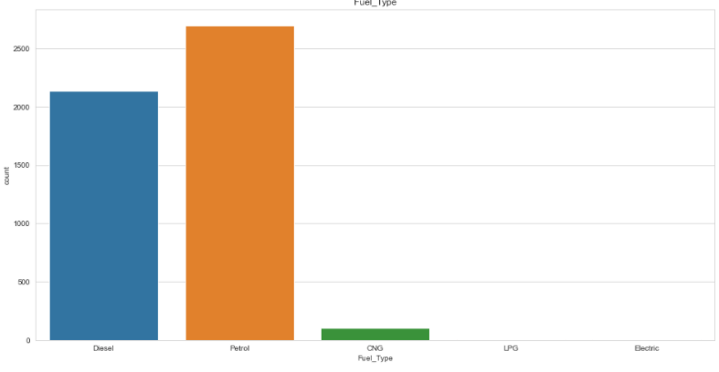
Fuel Type
There are 2699 petrol cars, 2139 diesel cars, 100 CNG cars , 5 LPG cars and 3 electronic cars in the given data set

Slide 4
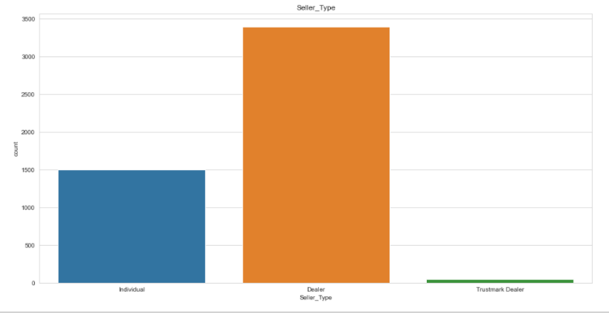
Seller Type
most of the cars are fed by the dealers in the given dataset. 3399 cars are from dealers, 1503 cars are from Individual owners and 44 are from Trustmark Dealers

Slide 5
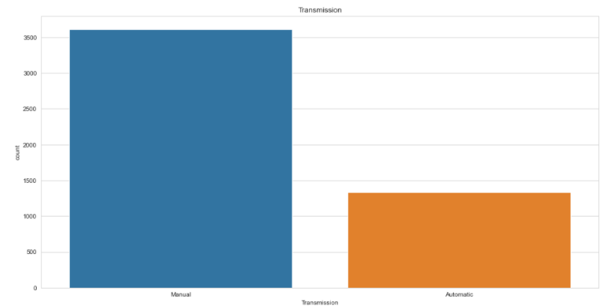
Transmission
There are 3616 Manual transmission and 1330 Automatic transmition cars in the given data set

Slide 6
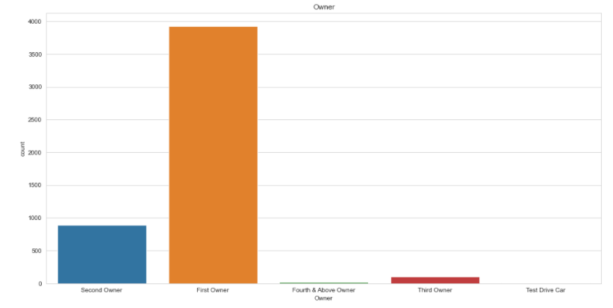
Owner
most of the cars second hand cars as the first owner itself is selling most of the cars as per given data set

Slide 7
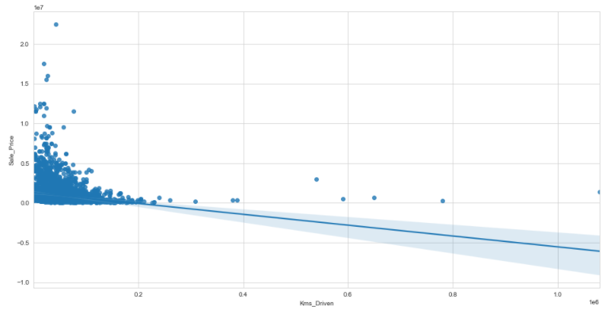
Selling price Vs Kms_Driven
More number of kilo meters driven feature reduces the selling price of used cars

Slide 8
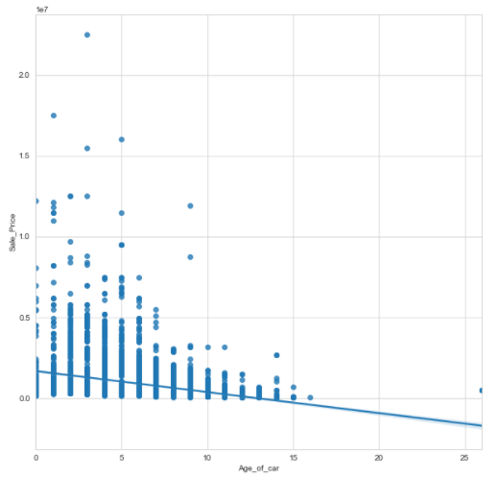
Selling Price Vs Age of car
it shows that
increase in the
age of the car
reduces the
selling price,
which is expected
as Depreciation of
An assest

Slide 9
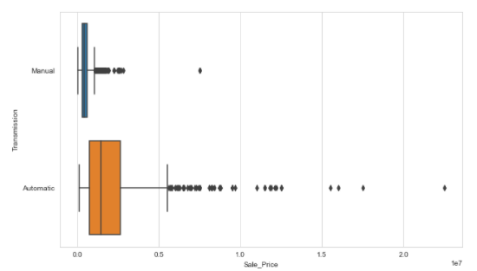
Selling Price Vs Transmission
Automatic trasmission cars price is high in the given data set

Slide 10
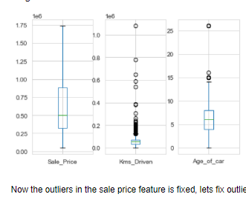
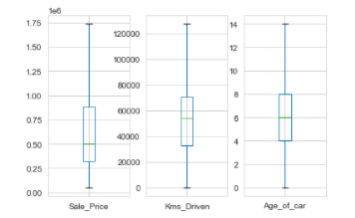
Outliers fix
Automatic trasmission cars price is high in the given data set
Before After

Slide 11
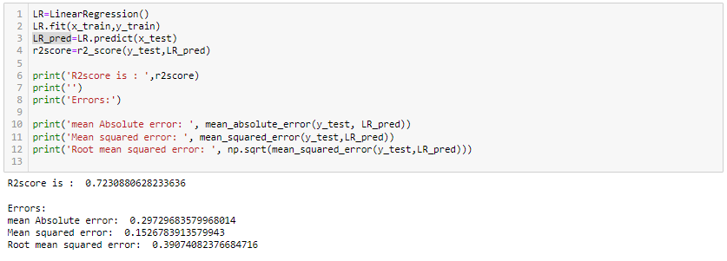

Model Building
Linear regression
Cross Validation

Slide 12
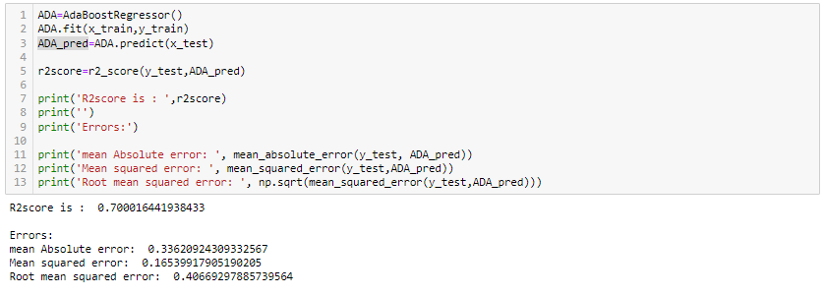
Model Building
ADA Boost regression
Cross Validation

Slide 13
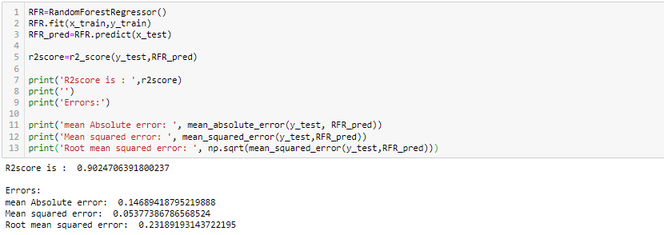
Model Building
Random forest regression
Cross Validation

Slide 14
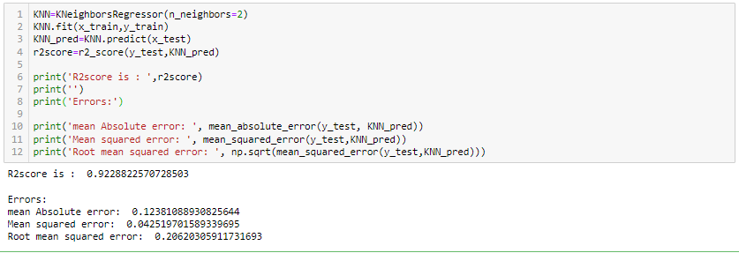
Model Building
KNN regression
Cross Validation

Slide 15
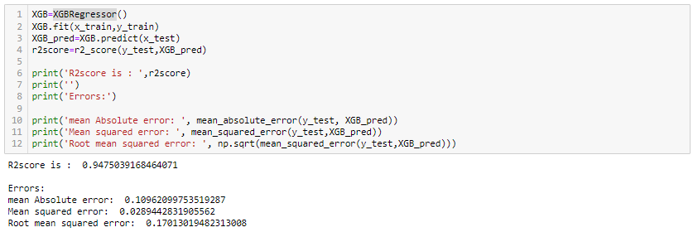
Model Building
XGBoost regression
Cross Validation

Slide 16
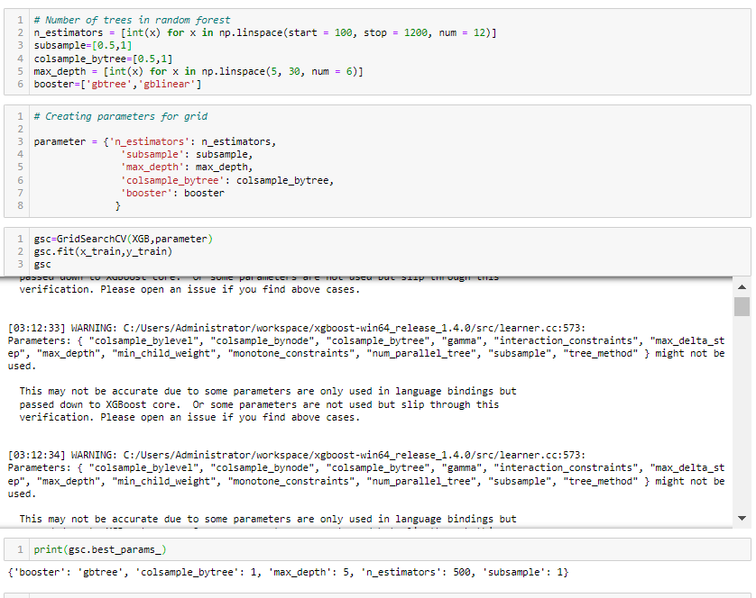
Hyper parameter tunning

Slide 17
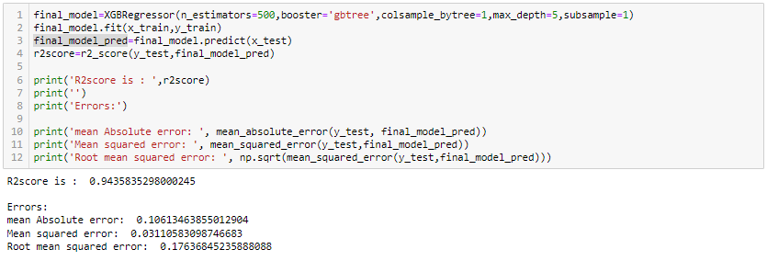
Final model

Slide 18
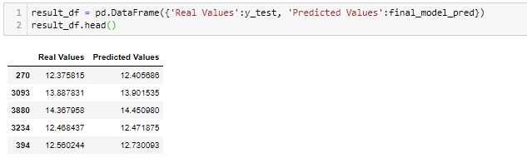
Actual Vs Predicted

